Slide 1
Visual Rewards Experiment

Slide 2
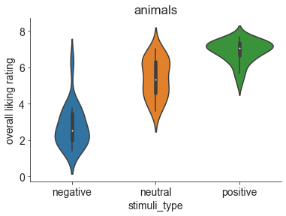
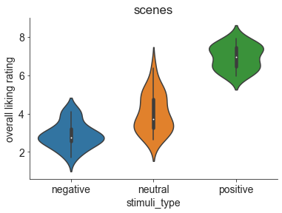
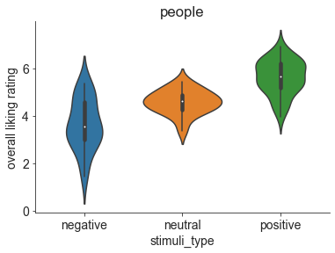
Distribution of average liking ratings

Slide 3
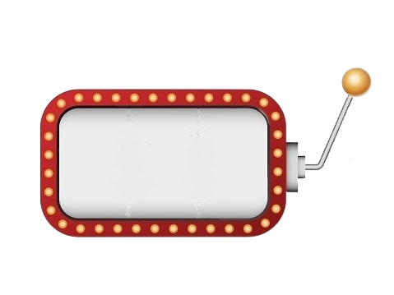
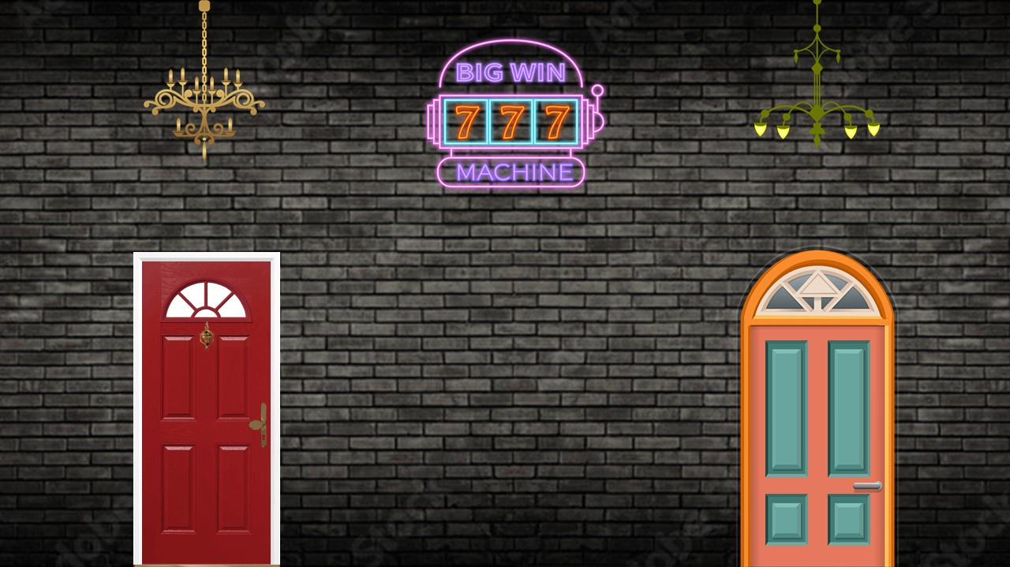
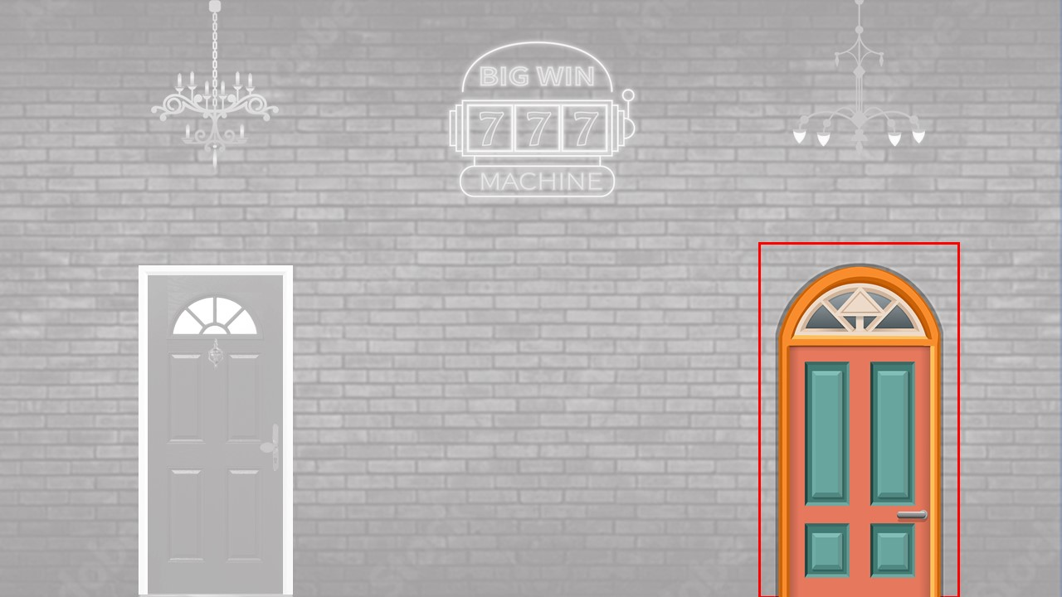

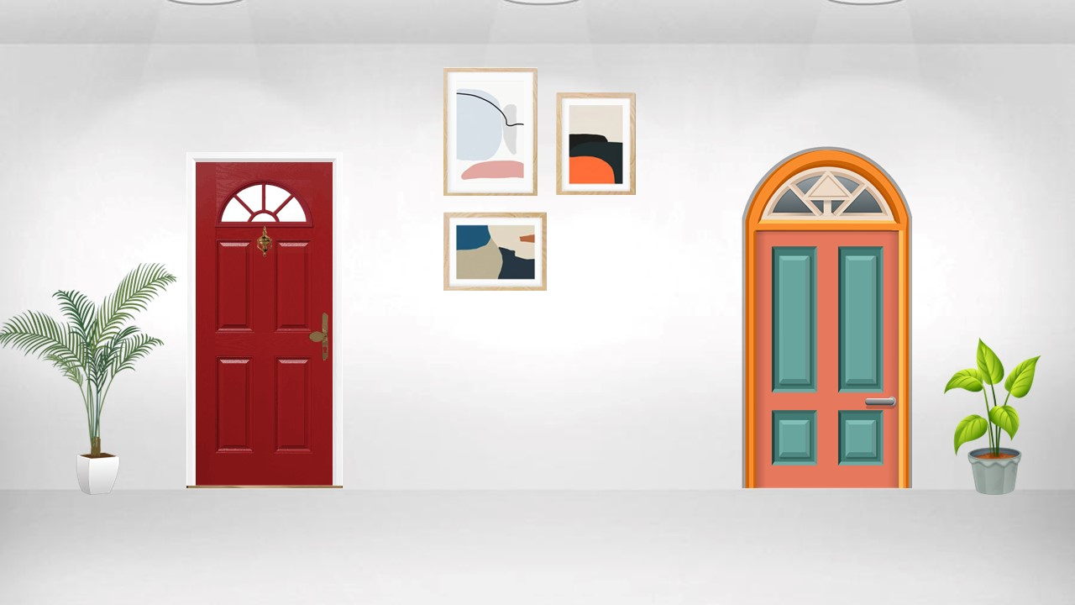

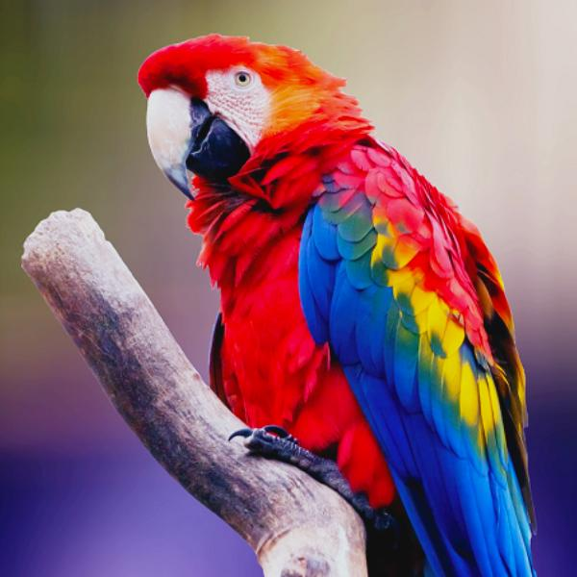
Trial structure
Choose left or right
Highlight choice
Feedback
6.78
2.5 s
0.5 s
1.5 s

Slide 4
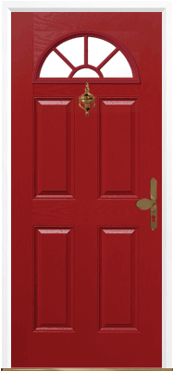
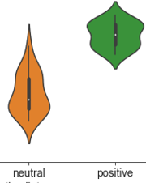

Feedback distribution
We plan to have separate rewarding and aversive tasks. So the current task has only positive and neutral stimuli
probability 0.8
Image or corresponding rating
Positive
Arm
probability 0.2
probability 0.5
draw
feedback
probability 0.2
Image or corresponding rating
Neutral
Arm
probability 0.8

Slide 5
Task structure
6 *
6 *
6 *
10 trials
(same category)
18 runs
A run
3 categories
40 s per run * 18 runs = 12 min
Randomised order for 18 runs
2 tasks (points and images) * 18 runs per task = 24 min

